Slide 1
CPE413 Kablosuz Ağlar
Bilgisayar Mühendisliği Bölümü, Mühendislik Fakültesi
Dr. Sait DEMİR
saitdemir@karabuk.edu.tr
September 29, 2021

Slide 2
Wireless LAN Technology and the IEEE 802.11 Wireless LAN Standard
Notes:
1.IEEE 802.11 Features
2.IEEE 802.11 Physical Layers
3.IEEE 802.11 MAC
4.IEEE 802.11 Architecture
5.Frame Format

Slide 3
Outline
Introduction WLAN
IEEE 802.11 Standards
WLAN Architecture
IEEE 802.11 Protocol Architecture
IEEE 802.11 LCC
EEE 802.11 MAC
MAC Frame Format

Slide 4
KABLOSUZ AĞLAR
Wireless communication technology, in its simplest definition, is a technology that provides point-to-point connection or a network structure. From this perspective, wireless communication technology is similar to wired or fiber optic communication structures that are widely used today.
The point that distinguishes wireless communication technology from others is; It uses air as the transmission medium.
■ While metal cables transmit electric current, wireless and optical transmission systems transmit electromagnetic waves at a certain frequency.
■ Wireless network standards, wireless network protocols, wireless network modes and wireless communication methods have been developed to ensure wireless communication.

Slide 5
KABLOSUZ AĞLAR
Wireless local area network (WLAN) are communication networks that provide two-way broadband data communication, use Radio Frequency (RF) or Infrared (IR) rays instead of cables as transmission medium, and operate in a limited area such as a building or campus.
Wireless local area networks are often used to extend the boundaries of a wired local area network. These networks operate according to IEEE 802.11 standards. Wireless LAN (WLAN) systems provide users with various opportunities such as wireless broadband internet access, access to applications on the server, e-mail service and file sharing between users connected to the same network.
The distance of wireless LAN systems is around 25-100 meters. There are two types of wireless LAN technologies widely used in the world. One of these is America-based IEEE 802.11x, and the other is Europe-based HiperLAN systems.

Slide 6
KABLOSUZ AĞLAR
Wireless local area networks are called RLAN (Radio Local Area Networks) in European regulations, Wi-Fi (Wireless Fidelity), Wireless Local Area Networks, WLAN in the USA and many countries.
Wireless LAN systems, which have all the features of wired LANs, are used as a continuation or alternative to wired networks. Wireless LAN systems provide individual users with the opportunity to connect to the network in many areas such as businesses, cafes, libraries, schools and campuses.

Slide 7
KABLOSUZ AĞLAR
Many advantages are gained through the use of wireless LANs. These advantages can be divided into intra-building and inter-building advantages.
intra-building;
➢Mobility: There is no need to fix computers in a wireless LAN system. Therefore, users' freedom of movement is ensured and work efficiency increases.
➢ Installation speed and flexibility: Before installing a wired LAN, a certain amount of time is spent on the required cabling plan and cabling process. Since these operations are not required in the wireless WLAN system, time is saved and the installation of the system is accelerated. It also provides easy access to the network in places where cable installation is difficult.
Low cost: Although wireless networks vary depending on the system to be installed, they are generally lower cost than wired networks. Because there is no cable cost or cabling labor fee.
➢ Scalability: Internet access can be provided from anywhere in environments where the number of users is not fixed (campus, library, restaurant, conference hall, etc.). Since it does not require additional materials and workload during users' participation in the system, the network can be expanded to any number of times.

Slide 8
KABLOSUZ AĞLAR
Many advantages are gained through the use of wireless LANs. These advantages are organized as intra-building and inter-building advantages.
intra-building;
➢ It works as an alternative to lighting with 11 Mbps speed switches.
➢ Fixed communication/maintenance costs are minimal.
➢ Provides communication security with 128 bit encryption.
➢ Wireless connection between buildings can be achieved for operations or rotators in dispersed structures.

Slide 9
KABLOSUZ AĞLAR
Despite the flexibility and advantages of wireless connectivity, it has some limitations and risks. The disadvantages of wireless networks are:
➢ Interference: Wireless LAN technologies use unlicensed regions of the electromagnetic spectrum, that is, since these regions are unregulated, many different signals use these regions. As a result, these areas become congested and signals from different devices such as cordless phones and microwaves can interfere with the network.
➢ Network and data security: Wireless LAN technology is designed not to ensure the security of the data being transmitted, but to provide access to that data. This feature of the wireless connection causes unwanted receivers (clients) to interfere with the communication flow, thus causing security threats. Techniques such as encryption and authentication have been developed to prevent security threats in wireless LANs.
➢ Technology: Wireless LAN technology continues to evolve. Wireless LAN technology does not currently provide the speed and reliability of wired LANs.

Slide 10
KABLOSUZ AĞLAR
It can be said that wireless LAN is actually making the physical layer (Ethernet, etc.) and partially the data link layer of existing LAN technologies wireless.
For this purpose, international standards have been determined for wireless LAN.
■ Wireless network standards started to be developed by the Institute of Electrical and Electronics Engineers, IEEE (Institute of Electrical and Electronics Engineers) since 1997.
■ The general name of this developed standard is IEEE 802.11 and it includes wireless local network protocols. There are also HiperLAN1 and HiperLAN2 standards defined by ETSI.
■ The 802.11 standard represents the rules used when communicating over a wireless local area network, WLAN (Wireless Local Area Network).

Slide 11
KABLOSUZ AĞLAR
■ IEEE 802.11, operating at 2.4 GHz, maximum 75
covering meters and offering data transmission speeds in the range of 1-2 Mbps.
This standard has become inadequate as a result of technological developments.
With the advent of the development of the series of standards called 802.11x has started.
■ Although there are differences, the 802.11 family is basically the same
uses communication rules.
■ 802.11a, 802.11b, 802.11g, 802.11n are the most used of these standards.
■ 802.11ac, 802.11ad, 802.11ax are new standards.

Slide 12
Introduction
Wireless LANs (WLANs)
Indispensible adjunct to wired LANs
Wireless devices use WLANs
As their only source of connectivity
Or to replace cellular coverage
Simple WLAN configuration
There is a backbone wired LAN
User modules include workstations, servers, devices
Control module (CM) interfaces to WLAN
Providing bridge or router functionality
May have control logic to regulate access
May provide wireless connectivity to other wired networks
Notes:
Wireless LANs (WLANs) play an important role life especially during this pandemic
Wireless LANs are an indispensable
adjunct to traditional wired LANs, to satisfy requirements for mobility, relocation, ad hoc networking, and coverage of locations difficult to wire.
wireless LAN is one that makes use of a wireless transmission
medium for a local area network

Slide 13
11.1 Example Single-Cell Wireless LAN Configuration
Notes:
Simple WLAN configuration
There is a backbone wired LAN
User modules include workstations, servers, devices
Control module (CM) interfaces to WLAN
Providing bridge or router functionality to link the wireless LAN to the backbone
May have control logic to regulate access
May provide wireless connectivity to other wired networks
Hubs or other user modules (UMs) that control a number of stations off a wired LAN may also be part of the wireless LAN configuration.

Slide 14
Introduction
Multiple-cell wireless LAN
Multiple CMs connected by a wired LAN
Creates many issues for balancing cell loading and providing best connections for Ums
Wireless LAN Technology and the IEEE 802.11 Wireless LAN Standard 11-14
Notes:
Another common configuration, suggested
by Figure 11.2, is a multiple-
Cell wireless LAN.

Slide 15
11.2 Example Multiple-Cell Wireless LAN Configuration
Notes:
there are multiple control modules interconnected by a wired LAN.
ach control module supports a number of wireless end systems within its transmission range
IEEE 802.11ad WLAN, transmission is limited to a single room due to its use of 60
GHz frequencies; therefore, one cell is needed for each room in an office building
that requires wireless support.

Slide 16
Wireless Network Structures
■ Wireless networks basically work in two different structures: One of them is
Ad-hoc and the other one is called Infrastructure mode.
■ Generally, one of these two modes should be selected depending on the intended use of the wireless network.
Wireless LAN Technology and the IEEE 802.11 Wireless LAN Standard 11-16

Slide 17
Ad Hoc Networking
■ Ad-hoc mode is the situation in which two wireless network devices can communicate without the need for another interconnector, that is, AP (Access Point).
■ Technically known as Independent Basic Service Set (IBSS). Ad-hoc connections are often used for personal work at home.
■ Since there is no central device in ad-hoc mode, it is difficult to ensure management and security.
Wireless LAN Technology and the IEEE 802.11 Wireless LAN Standard 11-17

Slide 18
Ad Hoc Networking
■ For example, if there are two computers in a house, one of these computers has an internet connection and you want to connect the other computer to the internet, there are two options.
■ Either the two computers should be connected directly to each other by pulling a cable between the two computers,
■ Or the two computers should be connected through these intermediary devices using a hub/switch.
■ However, there is another option other than these.
■ By setting the wireless network adapters of these two devices to work in Ad-hoc mode and by sharing the connection on the computer accessing the internet, both machines will be able to use the internet freely.
Wireless LAN Technology and the IEEE 802.11 Wireless LAN Standard 11-18

Slide 19
11.3 Ad Hoc Wireless LAN Configuration
Notes:
shows a wireless LAN
configured as an ad hoc wireless LAN. A peer collection of stations within the
range of each other may dynamically configure themselves into a temporary network

Slide 20
Infrastructure Mode
Infrastructure mode requires a device such as an AP (Access Point) to communicate with wireless network devices in the environment.
■ It is slightly more complex than ad-hoc mode and configures the operating system to use this mode unless it has specifically set it up.
■ Technically known as “Basic Service Set” (BSS).
■ In infrastructure mode, wireless network clients think they are interacting with each other directly, but all packets are transmitted through the AP. Here, there is a risk that any wireless network device that is not included in the network will monitor all traffic.
Wireless LAN Technology and the IEEE 802.11 Wireless LAN Standard 11-20

Slide 21
Infrastructure Mode
■ Therefore, when using Infrastructure mode, communication is usually encrypted. Protocols such as WEP or WPA are used for encryption purposes. In encrypted communication, even if the traffic in between is monitored, it will be unintelligible.
■ In this type of structure, the access point acts as a HUB by providing wireless transmission of computers.
Wireless LAN Technology and the IEEE 802.11 Wireless LAN Standard 11-21

Slide 22
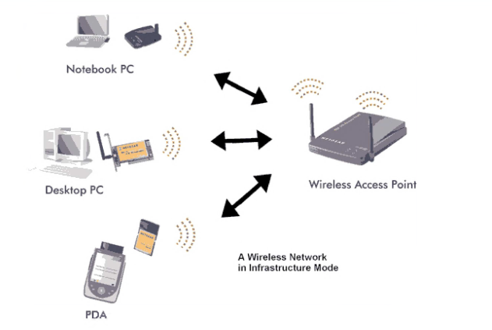
Infrastructure Mode
Wireless LAN Technology and the IEEE 802.11 Wireless LAN Standard 11-22

Slide 23
Comparison of Ad-Hoc and Infrastructure Modes
■ Ad-hoc mode provides convenience in setting up a small temporary network as it does not require the use of an access point.
■ In Infrastructure mode, the access point's ability to cover a wide area is utilized. However, in Ad-hoc mode, there is a limited connection between a small number of computers.
■ In ad-hoc mode, performance is high because packets are not transported through access points; but this is valid for a small number of users. In wireless networks with a large number of users, higher performance is achieved in infrastructure mode.
Wireless LAN Technology and the IEEE 802.11 Wireless LAN Standard 11-23

Slide 24
Comparison of Ad-Hoc and Infrastructure Modes
■ Since the network topology may vary in ad-hoc mode, the priority in the system is the continuity of the connection. In this mode, when the topology changes, unexpected changes in data transmission and data transmission distance may occur. In Infrastructure mode, such problems are encountered less frequently.
■ In an Ad-hoc network consisting of many computers, the amount of interference increases and communication performance decreases because the computers will use the same frequency range to communicate. In Infrastructure mode, these problems are minimized.
■ Ad-hoc mode is difficult to manage and secure due to the absence of a central device. It is not possible for the network administrator to measure performance and take necessary security measures. Infrastructure mode is more useful in terms of management and security.
■ Ad-hoc mode costs less for a small number of users. For a large number of users, Infrastructure mode is cheaper
Wireless LAN Technology and the IEEE 802.11 Wireless LAN Standard 11-24

Slide 25
Features to Consider in Wireless Access Devices
■ Standards: Wireless LAN standards supported by the device.
■ Modulation: Modulation methods (OFDM) supported by the device
■ Data Transfer Values: Speed ​​​​values ​​at which data transfer is possible
■ Network Connection Type: Supported network connection type (Ad-Hoc, Infrastructure)
■ Operating Modes: Wireless connection modes in which it can operate. (access point, AP to AP Bridge, Point to MultiPoint Bridge, Wireless Client)
■ Frequency Band: The frequency range in which it operates in MHz. Transmitter
Wireless LAN Technology and the IEEE 802.11 Wireless LAN Standard 11-25

Slide 26
Features to Consider in Wireless Access Devices
■ Output Power: Transmitting power of the device (in dB)
■ Receiver Sensitivity: Receiving power of the device (in dB)
■ External Antenna Type: Type of antenna that can be attached to the device
■ Network Support: Networks where the device can be used (server and client).
■ Security: Security modes supported by the device: 64-bit, 128-bit 152-bit WEP encryption, WPA, 802.x etc.)
Wireless LAN Technology and the IEEE 802.11 Wireless LAN Standard 11-26

Slide 27
Ad Hoc Networking
Temporary peer-to-peer network set up to meet immediate need
Peer-to-peer, no centralized server
Maybe a temporary network
Wireless connectivity provided by WLAN or Bluetooth, ZigBee, etc.
Example:
Group of employees with laptops convene for a meeting; employees link computers in a temporary network for duration of meeting
Wireless LAN Technology and the IEEE 802.11 Wireless LAN Standard 11-27

Slide 28
Wireless LAN motivations
Cellular data offloading
The spectrum available in mobile cellular networks is limited and costly to consumers.
Cellular providers may encourage this to offload demand on their networks
Sync/file transfer
WLANs may provide higher data rates and more available capacity
Avoid use of cables
Internet access
Multimedia streaming
Notes:
Internet Access: Multi- Gigabit Wi-Fi enables faster Internet access, eliminating any significant bottlenecks from the WLAN.
Multimedia Streaming: Wi- Fi can be more suitable than other proposed wireless approaches because of its larger deployment, user awareness, support for IP networking, ease of connection,
and standardized security mechanism.

Slide 29
Wireless LAN Requirements ÖNEMLİ
Throughput: KAPASİTE The medium access control (MAC) protocol should make as efficient use as possible of the wireless medium to maximize capacity.
Number of nodes: need to support hundreds of nodes across multiple cells.
Connection to backbone LAN: interconnection with stations on a wired backbone LAN is required.
Service area: A typical coverage area for a WLAN has a diameter of 100 to 300 m.
Transmission robustness and security: design of a WLAN must permit reliable transmission even in a noisy environment
Battery power consumption
Collocated network operation
License-free operation
Handoff/roaming
Dynamic configuration
Wireless LAN Technology and the IEEE 802.11 Wireless LAN Standard 11-29
Notes:
A WLAN must meet the same sort of requirements typical of any LAN, including
high capacity, ability to cover short distances, full connectivity among attached stations, and broadcast capability.
Throughput: The medium access control (MAC) protocol should make as efficient use as possible of the wireless medium to maximize capacity.
• Number of nodes: WLANs may need to support hundreds of nodes across
multiple cells.
• Connection to backbone LAN: In most cases, interconnection with stations on a wired backbone LAN is required. For infrastructure WLANs, this is easily
accomplished through the use of control modules that connect to both types
of LANs
Service area: A typical coverage area for a WLAN has a diameter of 100 to
300 m.
• Battery power consumption:
Transmission robustness and security: Unless properly designed, a WLAN
may be especially vulnerable to interference and network eavesdropping. The
design of a WLAN must permit reliable transmission even in a noisy environment
and should provide security from eavesdropping.
• Collocated network operation: It is common for two or more wireless LANs to operate in the same area or in some area where interference between the WLANs is possible.
License-free operation: Users need to buy and operate WLAN products without
having to secure a license for the frequency band used by the WLAN.
• Handoff/roaming: The MAC protocol used in the WLAN should enable
mobile stations to move from one cell to another.
Dynamic configuration: The MAC addressing and network management
aspects of the WLAN should permit dynamic and automated addition, deletion, and relocation of end systems without disruption to other users.

Slide 30
11.4 Kiviat Graphs for Data Networks
Comparisons between WLANs, wired LANs, and mobile data networks can be visualized with Kiviat graphs.
A kiviat chart provides a pictorial way to compare systems across multiple variables.
Notes:
1A Kiviat graph provides a pictorial means of comparing systems along multiple variables.

Slide 31

IEEE 802.11 vs. Wi-Fi (ÖNEMLİ)
IEEE 802.11 is a standard
Wi-Fi = “Wireless Fidelity” is a trademark
802.11 has many options and it is possible for two equipment based on 802.11 to be incompatible.
Wi-Fi Alliance is a non-profit organization that does the compatibility testing (WiFi.org)
Industry consortium
Creates test suites to certify interoperability of products
May identify a subset of the standard for certification
Concerned with a range of market areas for WLANs
All equipment with “Wi-Fi” logo have selected options such that they will interoperate
Notes:
Generally people will interchangably use the two, but there re slightly different
But every company have their own point of view, and the standard says, you can do either one, so these options re available
What options we all choose,
If every body should follow, those common things should be followed by all, you might want to add something in addition to those common things
Wifi : what options we all choose
Wifi compliant can work with other

Slide 32
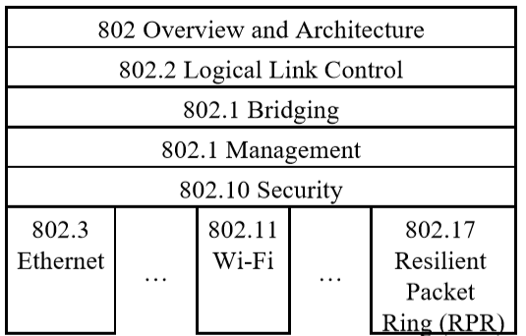
IEEE Standards Numbering System
IEEE 802.* and IEEE 802.1* standards apply to all IEEE 802 technologies:
IEEE 802.3 Ethernet, 802.5 token ring, 802.4 token bus
IEEE 802.11 Wi-Fi
IEEE 802.16 WiMAX
Notes:
802: Committee works on local area network
IEEE not too much to standard
1980, we design ethernet and ieee make it a standard
802 committee work on local area network
There re many 802 committees
802.5 token ring
802.4 token bus
If you re part of 802 you have to follow certain role, all 802 standards have the same security requirements/principles , these re common in 802 standard,
Wimax is before LTE, started by intel by
qualcom own tecom, and donot like the idea of intel take over, they come up with lte and wimax went away
Most work on cellular is done in ITU and 3GPP

Slide 33
IEEE Standards Numbering System (cont)
IEEE 802.11* (e.g., 802.11i) standards apply to all Wi-Fi devices but may not apply to ZigBee devices which are based on 802.15,
Standards with all upper case letters are base standards, e.g., IEEE 802.1AB-2009
Standards with lower case are additions/extensions/revisions. Merged with the base standard in its next revision. e.g., IEEE 802.1w-2001 was merged with IEEE 802.1D-2004
Standards used to be numbered, sequentially, e.g., IEEE 802.1a, …, 802.1z, 802.1aa, 802.1ab, …
Recently they started showing base standards in the additions, e.g., IEEE 802.1Qau-2010
Notes:
If someone want to small change, will be given a letter after it
Small extension and may disappear and merge in the main standard

Slide 34
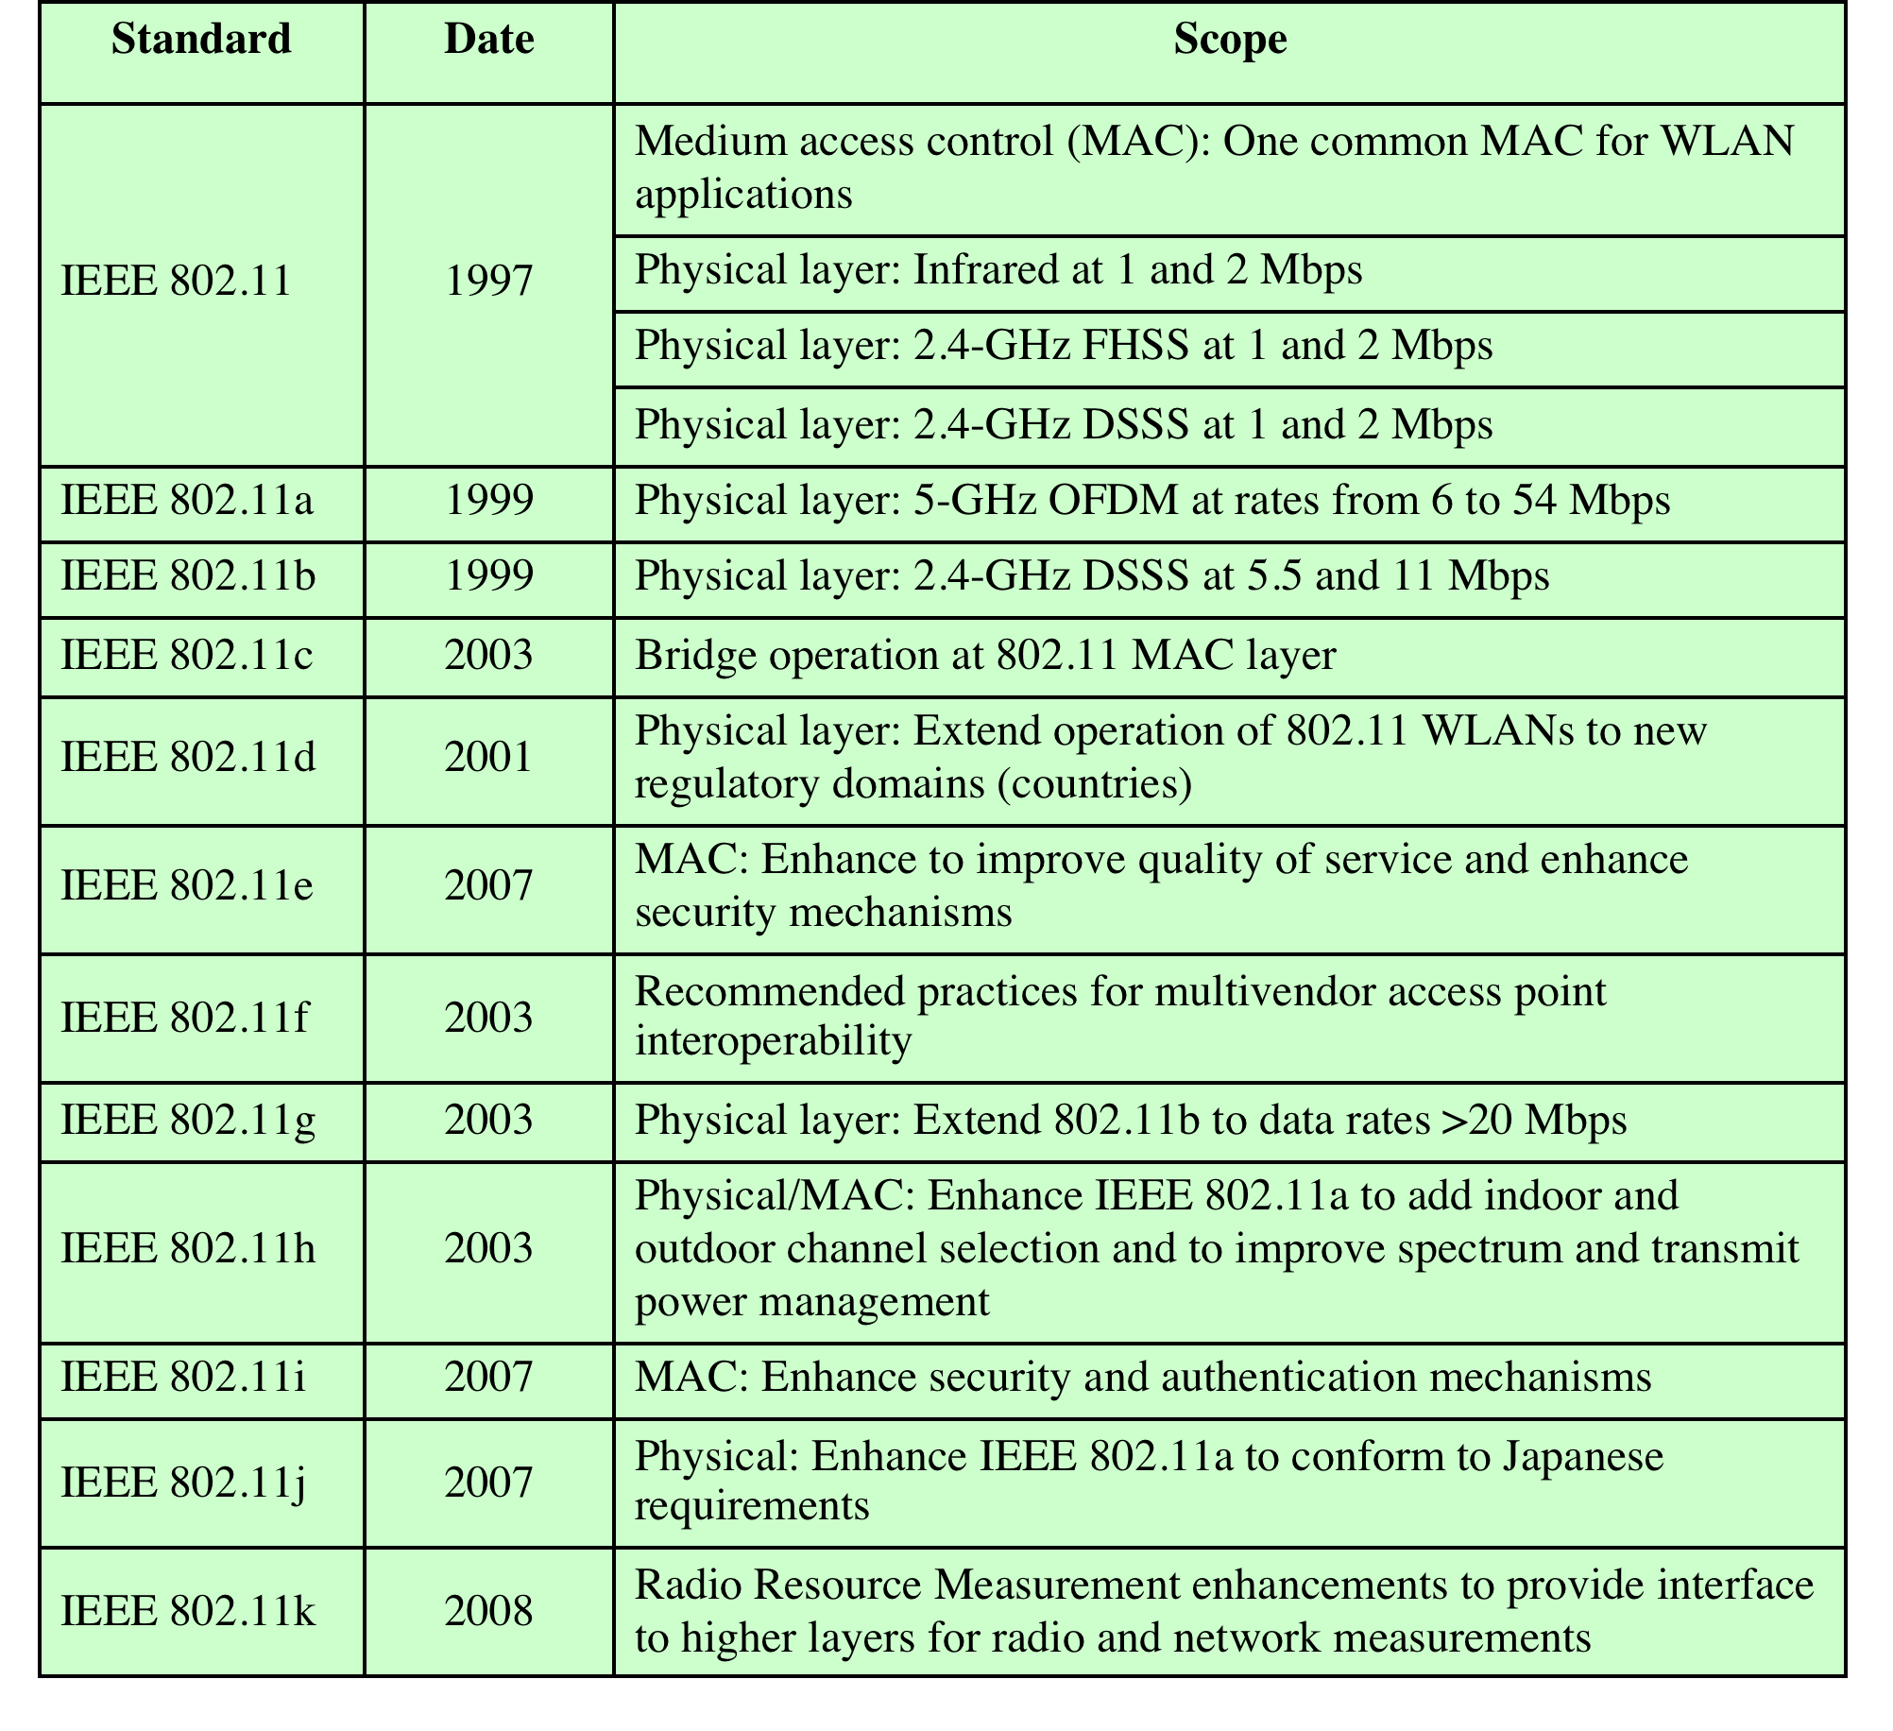
IEEE 802.11 Standards
Table 11.1 IEEE 802.11 Standards
Wireless LAN Technology and the IEEE 802.11 Wireless LAN Standard 11-34
Notes:
Issued in several stages
First version in 1997: IEEE 802.11
Includes MAC layer and three physical layer specifications
Two in 2.4-GHz band and one infrared
All operating at 1 and 2 Mbps
No longer used
Two additional amendments in 1999:
IEEE 802.11a-1999: 5-GHz band, 54 Mbps/20 MHz, OFDM
IEEE 802.11b-1999: 2.4 GHz band, 11 Mbps/22 MHz
Fourth amendment:
IEEE 802.11g-2003 : 2.4 GHz band, 54 Mbps/20 MHz, OFDM

Slide 35
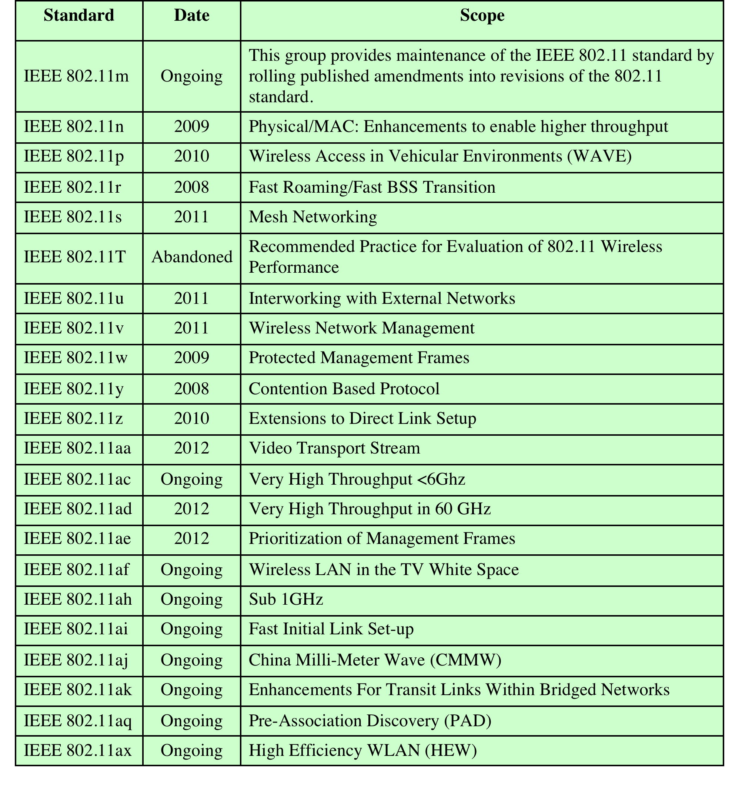
IEEE 802.11 Standards
Wireless LAN Technology and the IEEE 802.11 Wireless LAN Standard 11-35

Slide 36
802.11a Standardı
■ It is the first improved version that appeared in 1999, when the 802.11 standard became inadequate.
■ Although this standard is basically similar to 802.11, it operates at 5 GHz frequency. This standard, which offers a data transmission rate of 54 Mbps, can operate up to a maximum of 100 meters in open areas.
■ The main advantage that distinguishes 802.11a from other wireless network standards is that it supports more capacity and has more channel capacity, thus allowing more bandwidth usage.
■ Unlike other standards, 802.11a's operation at 5 GHz frequency has provided this standard with various advantages and disadvantages.

Slide 37
802.11a Standardı
■ The positive side of broadcasting on this frequency is that the channel capacity increases and the data transmission speed is higher due to the fact that other electronic devices such as Bluetooth, microwave ovens and cordless phones use different frequency ranges.
■ 802.11a's coverage area in closed areas is lower than other standards because broadcasts made on the 5 GHz frequency are absorbed more by obstacles such as walls.
■ This technology is actively used by users who need high data transmission speed and in video distribution systems. Although it is available in more expensive devices, it is preferred by corporate users in business life.

Slide 38
802.11b Standardı
■ The 802.11b standard was released in 1999 along with 802.11a. However, it became widespread in a much shorter time than 802.11a and began to be used all over the world.
■ 802.11b operates in the 2.4 GHz frequency band, like 802.11, and can reach a data transmission speed of 11 Mbps.
■ When it was first released, 802.11b became a rival to Ethernet technology due to the data transmission speed it could reach and played a major role in the widespread use of wireless networks.
■ The most important advantage of 802.11b is its long coverage distance.
■ Since it broadcasts at the 2.4 Ghz frequency, it can cover an area of ​​approximately 38 meters in closed areas and over 150 meters in open areas.

Slide 39
802.11b Standardı
■ Since Bluetooth operates at the same frequency with different electronic devices such as microwave ovens and cordless phones, the signals interfere with each other.
■ Data transmission speed and bandwidth are lower than 802.11a.
■ It is quite affordable compared to other standards in terms of cost.
■ 802.11b is generally well suited for use in environments such as office environments, hospitals, warehouses and factories.
■ It is a suitable technology for providing network connections, especially in conference halls, work areas and places where pulling cables is dangerous.

Slide 40
802.11g Standardı
■ It is the 3rd generation technology developed by IEEE in wireless network standards in 2003.
■ It operates at 2.4 GHz frequency, just like 802.11 b.
■ The 802.11g standard is basically an extension of the 802.11b standard, but with significant improvements in data transmission speed and bandwidth used.
■ The most important feature of 802.11g is that it increases the data transmission rate to an average of 22 Mbps while preserving the coverage area achieved with 802.11b. This speed can reach a maximum of 54 Mbps, as in 802.11a.

Slide 41
802.11g Standardı
■ This standard has not become widely used due to occasional compatibility problems with devices that work with 802.11b.
■ The fact that its price is higher than 802.11b also reduces its preferability.
■ The 802.11g standard is quite suitable for video and multimedia applications that require high speed, due to its speed and the width of the area it covers.

Slide 42
802.11n Standardı
■ The increase in the number of users over time and the fact that users want to use different applications have increased demands such as more bandwidth, more accessibility and wider coverage area. For this purpose, IEEE started working to develop the 802.11n standard in 2003.
■ The 802.11n standard, published in October 2009, was created by the development of 802.11b and 802.11g wireless networks.
■ With this technology, it is aimed for wireless devices to cover a wide area and transmit data as fast as wired networks.
■ With 802.11 n technology, high resolution video can be watched and voice and video calls can be made wirelessly.
■ The stability, performance and reliability offered by wired LAN systems are also provided by 802.11n standards.
■ The data transfer rate of the 802.11n standard can reach up to 540 Mbps.
■ Access Points produced according to the 802.11n standard can communicate at both 2.4 GHz and 5 GHz frequencies. In this way, it will be able to work in harmony with devices produced with 802.11a, b, g standards.
■ The most important feature of the 802.11n wireless LAN standard is that it works with multiple antenna technology called MIMO.

Slide 43
802.11n Standardı
■ 802.11n kablosuz LAN standardın en önemli özelliği MIMO adı verilen çoklu anten teknolojisi ile çalışmasıdır.
■ MIMO (Multi Input - Multi Output) mekanizması günümüzde çoğunlukla iki alıcı ve iki gönderici (2X2) anten kullanılarak gerçekleştirilir.
■ Access Point bir veri göndermek istediği zaman bu veriyi kendi üzerindeki radyosuna iki ayrı koldan iletir.
■ İki ayrı koldan aynı anda havaya yollanan veri akışları doğal olarak farklı antenler üzerinden farklı ve belirli bir algoritma dâhilinde oynayan fazlarla iletilir.
■ Bu şekilde veri akışlarının birbiriyle çakışması önlenmiş olur. İki kat daha fazla veri iletilir.

Slide 44
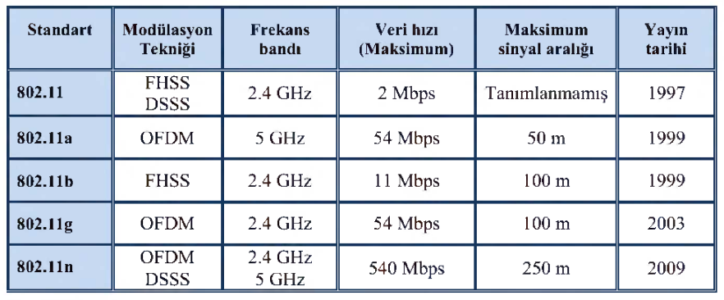
802.11 Yaygın Standartların Karşılaştırması

Slide 45
IEEE 802.11 Features
Original IEEE 802.11-1997 was at 1 and 2 Mbps. Newer versions at 11 Mbps, 54 Mbps, 108 Mbps, 200 Mbps,...
All versions use “License-exempt” spectrum
No licensing needed – Four microwave bands
902-928 MHz
2.4-2.5 GHz
5.725-5.875 GHz
58-64 GHz (60-GHz mmWave bands)
Higher capacity
Less competition
More expensive equipment
Supports multiple priorities
Supports time-critical and data traffic
Power management allows a node to doze off
Need ways to share spectrum among multiple users and multiple LANs Spread Spectrum (CDMA)
Spread spectrum
DSSS CDMA or OFDM
Over 1 Gbps possible with OFDM, channel bonding, and MIMO
Wireless LAN Technology and the IEEE 802.11 Wireless LAN Standard 11-45
Notes:
Original IEEE 802.11-1997 was at 1 and 2 Mbps. Newer versions at 11 Mbps, 54 Mbps, 108 Mbps, 200 Mbps,…
All versions use “License-exempt” spectrum
Need ways to share spectrum among multiple users and multiple LANs Spread Spectrum (CSMA)
Three Phys:
Direct Sequence (DS) spread spectrum using ISM band
Frequency Hopping (FH) spread spectrum using ISM band
Diffused Infrared (850-900 nm) bands
Supports multiple priorities
Supports time-critical and data traffic
Power management allows a node to doze off

Slide 46
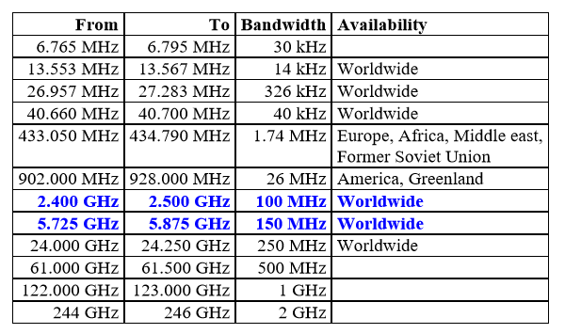
IEEE 802.11 Features
ISM Bands: Industrial, Scientific, and Medical bands. License exempt
Notes:
Bands are all license bands
We re moving to 61 GHZ
Cos 5GhZ band is getting used / full

Slide 47
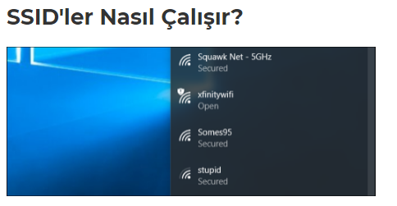
IEEE 802.11 Terimleri
Service Set Identifier (SSID): Service set identifier (SSID) is the logical name of wireless networks. It is used to tell wireless clients which wireless LAN they belong to and which other devices they can communicate with. Service set identifier, upper/lowercase, up to 32 characters
is a case-sensitive, alphanumeric string.
SSIDs are designed to be a unique name to distinguish between multiple Wi-Fi networks in the area so it can connect to the correct one.

Slide 48
IEEE 802.11 Terimleri
Erişim noktası (Access Point– AP): İstasyon işlevlerine sahip olan ve kablosuz ortam üzerinden kimliklerini tanıtmış olan (ilişkilendirilmiş olan) istasyonlar için dağıtım sistemine erişim olanağı sağlayan bir birimdir. Erişim noktası, BSS ile DS arasında köprü (bridge) işlevi yapar. Hücresel ağlardaki baz istasyonuna benzetilebilir.
Temel hizmet kumesi (Basic Service Set–BSS):Birbirini tanıyan ve birbiriyle iletişim kuran iki ya da daha fazla kablosuz düğümden ya da istasyondan oluşur. Bağımlı yada bağımsız olabilir. Arada herhangi bir cihaza ihtiyaç duymadan iletişim kuran cihazlar bağımısz BSS kullanır. Buna örnek olarak Ad-hoc ağlar verilebilr.
Eşgüdüm işlevi (Coordination Function): Bir BSS içindeki bir istasyonun ne zaman PDU (Protocal Data Unit: Protokol veri birimi) gönderebileceğine ve alabileceğine karar veren mantıksal işlevdir. Merkezi eşgüdüm (centralized coordination) ya da dağıtık eşgüdüm (distributed coordination) olmak üzere iki türdür.
Dağıtım sistemi (Distribution System–DS): BSS’ler ve portal üzerinden bağlantılı LAN’lar arasında iletişim sağlamak için kullanılan telli ta da telsiz bir iletişim ağıdır. Dağıtım sistemi; 2. katman ya da 3. katman anahtarı (layer 2 or layer 3 switch), kablolu ağ (wired network), omurga (backbone), kablosuz ağ (wirewless network) ya da herhangi bir iletişim ağı olabilir.

Slide 49
IEEE 802.11 Terimleri
Extended Service Set (ESS): A special type of SSID used to identify a wireless network containing access points.
It is a set of one or more BBSs using the same LLC protocol and connected (integrated) LANs via the portal.
MAC protocol data unit (MPDU): The data unit (MAC frame: MAC frame) used between the MAC sublayers of two mutually communicating stations.
MAC Service Data Unit (MSDU): The data unit (LLC-PDU) carried by the MAC frame.
Main portal: It is a bridge or router used to integrate IEEE 802.11 wireless LAN architecture with IEEE 802.x LANs over DS.
Station (STA): Any network device with a MAC sublayer and physical layer that complies with the IEEE 802.11 standard.

Slide 50
WIRELESS LAN Architecture
Distribution system (DS)
Access point (AP)
Basic service set (BSS)
Stations competing for access to shared wireless medium
Isolated or connected to backbone DS through AP
Extended service set (ESS)
Two or more basic service sets interconnected by DS

Slide 51

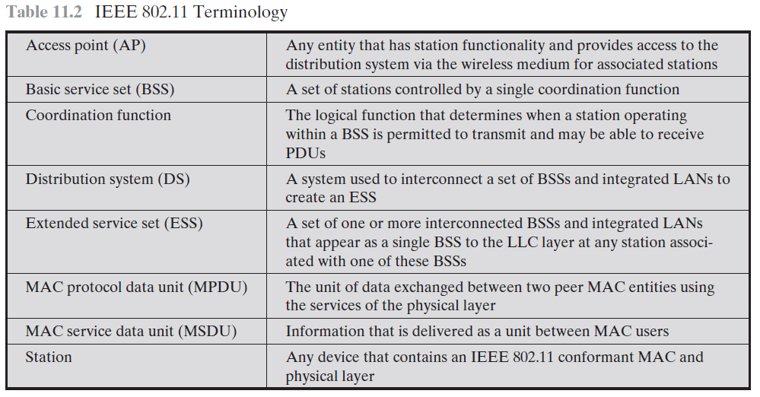
Notes:
Station services are
implemented in every 802.11 station, including AP stations.

Slide 52
11.8 IEEE 802.11 Architecture
Notes:
the model developed by the 802.11 working group.
The smallest
building block of a WLAN is a basic service set (BSS), which consists of some number of stations executing the same MAC protocol and competing for access to the same shared wireless medium.
The AP functions as a bridge and a relay point.
client stations do not communicate directly
with one another. Rather, if one station in the BSS wants to communicate with another station in the same BSS, the MAC frame is first sent from the originating station to the AP, and then from the AP to the destination station. Similarly, a MAC
frame from a station in the BSS to a remote station is sent from the local station to the AP and then relayed by the AP over the DS on its way to the destination station.
An extended service set (ESS) consists of two or more BSSs interconnected by
a distribution system
SSID: service set ID
You go to room and you find what service re in, ssid
The SSID (service set identifier) is the informal (human) name of the BSS (just like a Windows Workgroup name).
A BSS is functionally a contention domain as a local or workgroup network is functionally a broadcast domain.
In an ESS (extended service set) each BSS still has its BSSID, however, the entire ESS uses only one SSID called an ESSID (to facilitate laptop and mobile internet device, MID, mobility; and voice over wifi, VoWiFi, roaming).
Basic Service Area (BSA)= CellEach BSA may have several access points (APs)
Basic Service Set (BSS)= Set of stations associated with one AP
Distribution System (DS)-wired backbone
Extended Service Area (ESA)= Multiple BSAsinterconnected via a distribution system
Extended Service Set (ESS)= Set of stations in an ESA
Independent Basic Service Set (IBSS): Set of computers in ad-hoc mode. May not be connected to wired backbone.
Ad-hoc networks coexist and interoperate with infrastructure-based networks

Slide 53
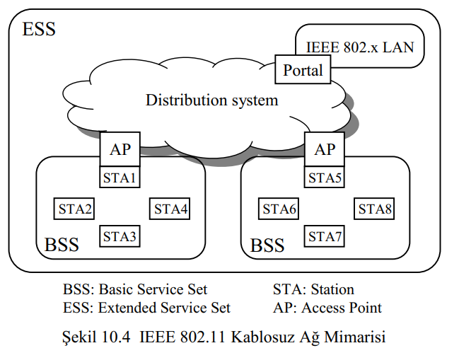
Introduction
IEEE 802.11 Architecture
Notes:
the model developed by the 802.11 working group.
The smallest
building block of a WLAN is a basic service set (BSS), which consists of some number of stations executing the same MAC protocol and competing for access to the same shared wireless medium.
The AP functions as a bridge and a relay point.
client stations do not communicate directly
with one another. Rather, if one station in the BSS wants to communicate with another station in the same BSS, the MAC frame is first sent from the originating station to the AP, and then from the AP to the destination station. Similarly, a MAC
frame from a station in the BSS to a remote station is sent from the local station to the AP and then relayed by the AP over the DS on its way to the destination station.
An extended service set (ESS) consists of two or more BSSs interconnected by
a distribution system
SSID: service set ID
You go to room and you find what service re in, ssid
The SSID (service set identifier) is the informal (human) name of the BSS (just like a Windows Workgroup name).
A BSS is functionally a contention domain as a local or workgroup network is functionally a broadcast domain.
In an ESS (extended service set) each BSS still has its BSSID, however, the entire ESS uses only one SSID called an ESSID (to facilitate laptop and mobile internet device, MID, mobility; and voice over wifi, VoWiFi, roaming).
Basic Service Area (BSA)= CellEach BSA may have several access points (APs)
Basic Service Set (BSS)= Set of stations associated with one AP
Distribution System (DS)-wired backbone
Extended Service Area (ESA)= Multiple BSAsinterconnected via a distribution system
Extended Service Set (ESS)= Set of stations in an ESA
Independent Basic Service Set (IBSS): Set of computers in ad-hoc mode. May not be connected to wired backbone.
Ad-hoc networks coexist and interoperate with infrastructure-based networks

Slide 54
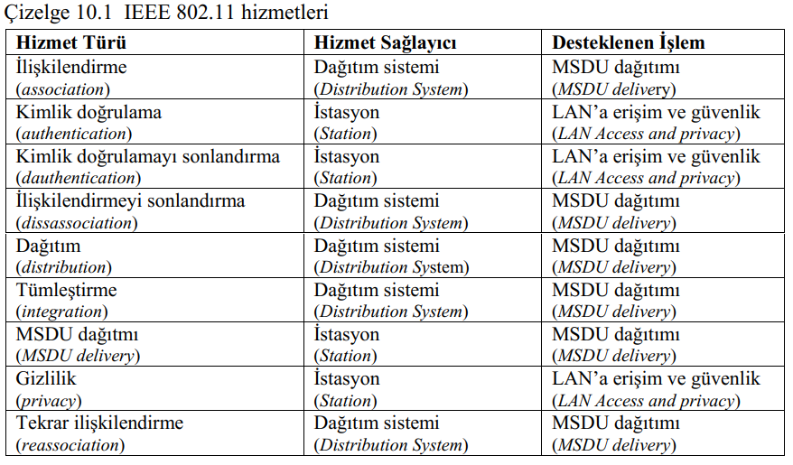
IEEE 802.11 Services
Association
Establishes initial association between station and AP
Reassociation
Enables transfer of association from one AP to another, allowing station to move from one BSS to another
Disassociation
Association termination notice from station or AP
Wireless LAN Technology and the IEEE 802.11 Wireless LAN Standard 11-54
Notes:
Station services are
implemented in every 802.11 station, including AP stations.
MAC service data units (MSDUs) between stations. The MSDU is the block of data passed
down from the MAC user to the MAC layer;

Slide 55
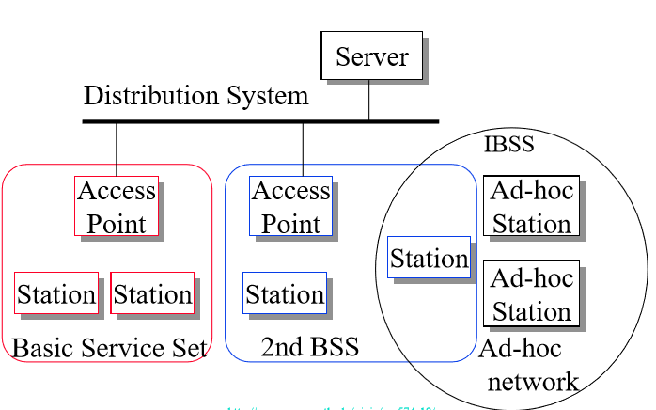
Introduction
IEEE 802.11 Architecture
Notes:
the model developed by the 802.11 working group.
The smallest
building block of a WLAN is a basic service set (BSS), which consists of some number of stations executing the same MAC protocol and competing for access to the same shared wireless medium.
The AP functions as a bridge and a relay point.
client stations do not communicate directly
with one another. Rather, if one station in the BSS wants to communicate with another station in the same BSS, the MAC frame is first sent from the originating station to the AP, and then from the AP to the destination station. Similarly, a MAC
frame from a station in the BSS to a remote station is sent from the local station to the AP and then relayed by the AP over the DS on its way to the destination station.
An extended service set (ESS) consists of two or more BSSs interconnected by
a distribution system
SSID: service set ID
You go to room and you find what service re in, ssid
The SSID (service set identifier) is the informal (human) name of the BSS (just like a Windows Workgroup name).
A BSS is functionally a contention domain as a local or workgroup network is functionally a broadcast domain.
In an ESS (extended service set) each BSS still has its BSSID, however, the entire ESS uses only one SSID called an ESSID (to facilitate laptop and mobile internet device, MID, mobility; and voice over wifi, VoWiFi, roaming).
Basic Service Area (BSA)= CellEach BSA may have several access points (APs)
Basic Service Set (BSS)= Set of stations associated with one AP
Distribution System (DS)-wired backbone
Extended Service Area (ESA)= Multiple BSAsinterconnected via a distribution system
Extended Service Set (ESS)= Set of stations in an ESA
Independent Basic Service Set (IBSS): Set of computers in ad-hoc mode. May not be connected to wired backbone.
Ad-hoc networks coexist and interoperate with infrastructure-based networks

Slide 56
Distribution of Messages Within a DS
Distribution service
Used to exchange MAC frames from station in one BSS to station in another BSS
Integration service
Transfer of data between station on IEEE 802.11 LAN and station on integrated IEEE 802.x LAN
Wireless LAN Technology and the IEEE 802.11 Wireless LAN Standard 11-56
Notes:
IEEE 802.11 defines nine services that need to be provided by the wireless LAN

Slide 57
Transition Types Based On Mobility
No transition
Stationary or moves only within BSS
BSS transition
Station moving from one BSS to another BSS in same ESS
ESS transition
Station moving from BSS in one ESS to BSS within another ESS
Wireless LAN Technology and the IEEE 802.11 Wireless LAN Standard 11-57
Notes:
Before looking at the concept of association, we need to describe the concept of mobility.
The standard defines three transition types, based on mobility:

Slide 58
Association-Related Services
Association
Establishes initial association between station and AP
Reassociation
Enables transfer of association from one AP to another, allowing station to move from one BSS to another
Disassociation
Association termination notice from station or AP
Wireless LAN Technology and the IEEE 802.11 Wireless LAN Standard 11-58
Notes:
Before the distribution service can deliver data to or accept data from a station, that station must be associated.

Slide 59
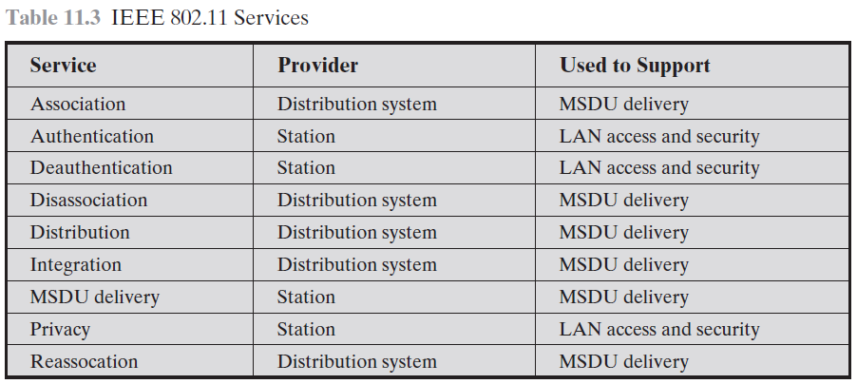
IEEE 802.11 Services
Association
Establishes initial association between station and AP
Reassociation
Enables transfer of association from one AP to another, allowing station to move from one BSS to another
Disassociation
Association termination notice from station or AP
Wireless LAN Technology and the IEEE 802.11 Wireless LAN Standard 11-59
Notes:
Station services are
implemented in every 802.11 station, including AP stations.
MAC service data units (MSDUs) between stations. The MSDU is the block of data passed
down from the MAC user to the MAC layer;

Slide 60
IEEE 802.11 Standard
IEEE 802.11 Protocol Architecture
IEEE 802.11 LCC
EEE 802.11 MAC
MAC Frame Format
Notes:
We will talk about wireless network: WLAN
LCC” logical link control
MAC: Medium access control
Standard

Slide 61
IEEE 802.11 Standard
MAC adresleri: LAN üzerindeki kaynak ve varış makinelerin (yönlendirici, köprü, bilgisayar, v.b.) fiziksel bağlantı adresleridir (MAC addresses are the addresses of physcal attechment points of the machines on the LAN).
LLC adresleri: LLC addresses are the addresses of service access points (SAP: Service Access Point) that specify the source and destination addresses of LLC users (network layer entities).
Notes:
We will talk about wireless network: WLAN
LCC” logical link control
MAC: Medium access control
Standard

Slide 62
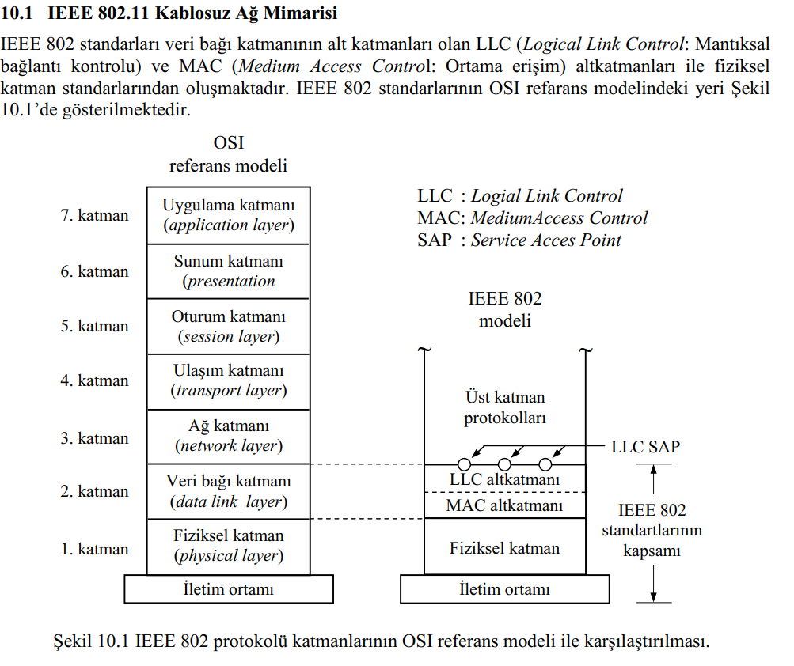

Notes:
We will talk about wireless network: WLAN
LCC” logical link control
MAC: Medium access control
Standard

Slide 63
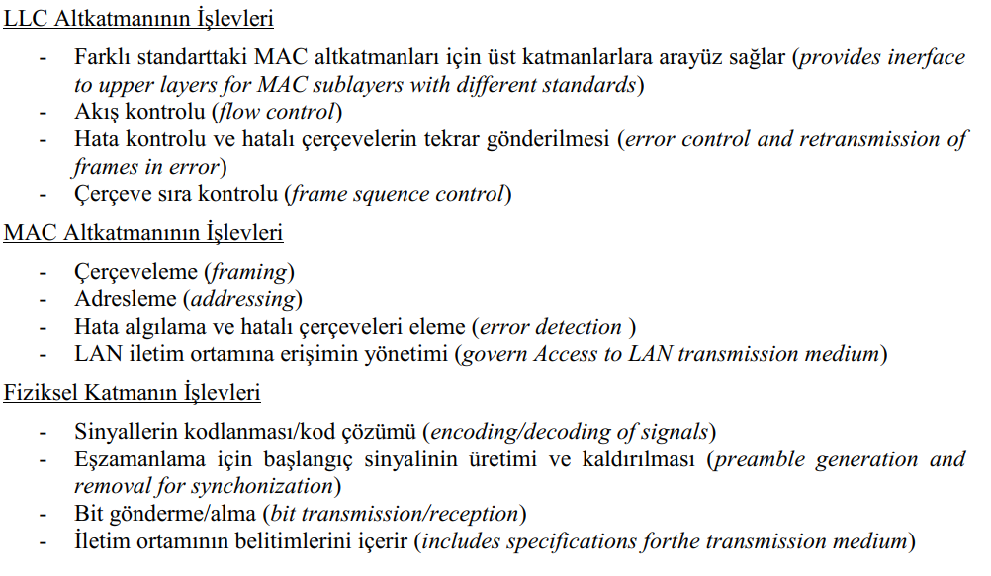
IEEE 802.11 Protocol architecture
Notes:
The IEEE 802.11 working group developed the most prominent specification for WLANs.
The architecture of a LAN is best described in terms of a layering of protocols that organize the basic functions of a LAN

Slide 64
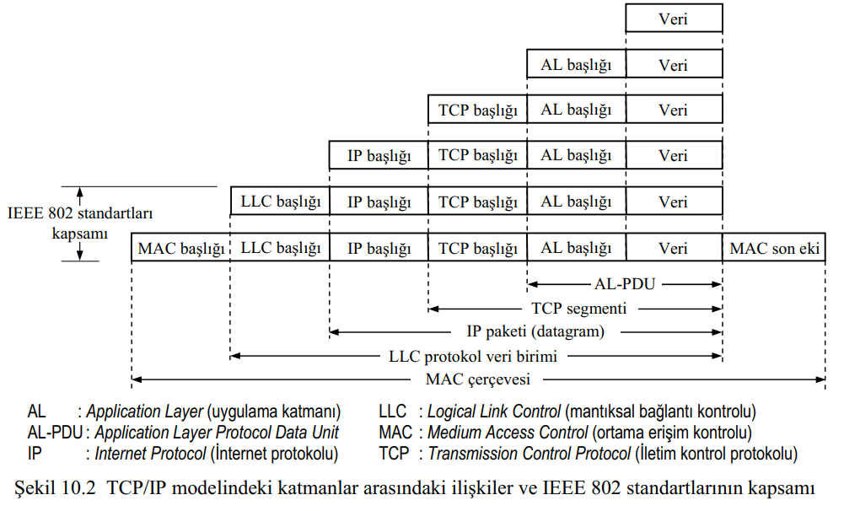

IEEE 802.11 Protocol architecture
Notes:
The IEEE 802.11 working group developed the most prominent specification for WLANs.
The architecture of a LAN is best described in terms of a layering of protocols that organize the basic functions of a LAN

Slide 65
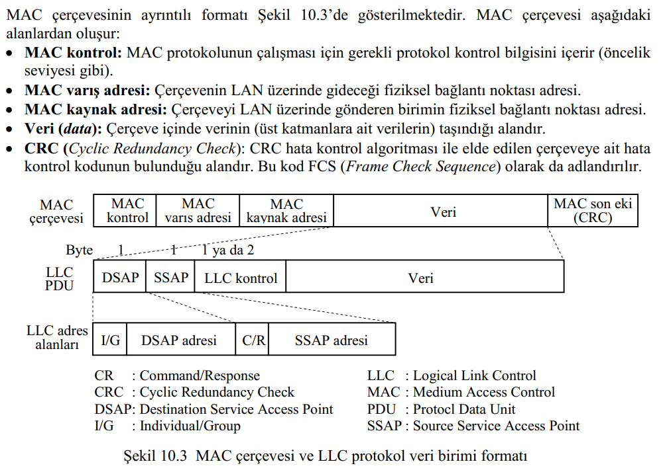

IEEE 802.11 Protocol architecture
Notes:
The IEEE 802.11 working group developed the most prominent specification for WLANs.
The architecture of a LAN is best described in terms of a layering of protocols that organize the basic functions of a LAN

Slide 66
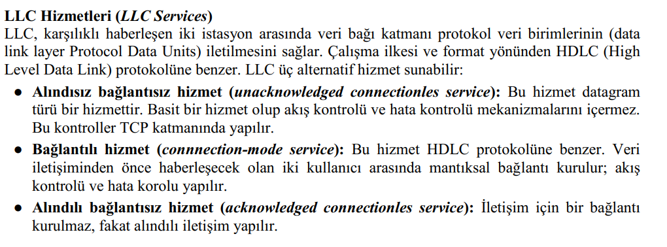
IEEE 802.11 Protocol architecture
Notes:
The IEEE 802.11 working group developed the most prominent specification for WLANs.
The architecture of a LAN is best described in terms of a layering of protocols that organize the basic functions of a LAN

Slide 67
IEEE 802.11 Protocol architecture
Developed by the IEEE 802.11 working group
Uses layering of protocols
LAN protocols focus on the lower layers of the OSI model
Figure 8.1 relates OSI with 802.11
Called the IEEE 802 reference model
Notes:
The IEEE 802.11 working group developed the most prominent specification for WLANs.
The architecture of a LAN is best described in terms of a layering of protocols that organize the basic functions of a LAN

Slide 68
8.1 IEEE 802 Protocol Layers Compared to OSI Model
Notes:
a discussion of LAN protocols is concerned principally
with lower layers of the OSI model
This architecture was developed by the IEEE 802 committee and has been adopted
by all organizations working on the specification of LAN standards
Functions of logical link control (LLC) Layer:
Provide an interface to higher layers and perform flow and error control
Functions of medium access control (MAC) layer:
On transmission, assemble data into a frame with address and error detection fields (MPDU = PLCP SDU )
On reception, disassemble frame and perform address recognition and error detection
Govern access to the LAN transmission medium
Functions of physical layer:
Encoding/decoding of signals
Preamble generation/removal (for synchronization)
Bit transmission/reception
• Physical layer convergence procedure (PLCP): Defines a method of mapping
802.11 MAC layer protocol data units (MPDUs) into a framing format suitable
for sending and receiving user data and management information between two
or more stations using the associated PMD sublayer.
• Physical medium dependent (PMD) sublayer: Defines the characteristics of,
and method of transmitting and receiving, user data through a wireless medium between two or more stations.

Slide 69
IEEE 802.11 Protocol Architecture
Functions of physical layer:
Encoding/decoding of signals
Preamble generation/removal (for synchronization)
Bit transmission/reception
Includes specification of the transmission medium
Sublayers
Physical layer convergence procedure (PLCP)
Mapping 802.11 MAC layer protocol data units (MPDUs) into a framing format
Sending and receiving between stations using same PMD sublayer
Physical medium dependent sublayer (PMD)
Transmitting and receiving user data through a wireless medium
Notes:
the physical layer is further subdivided into
sublayers. In the case of IEEE 802.11, two sublayers are defined:
• Physical layer convergence procedure (PLCP): Defines a method of mapping
802.11 MAC layer protocol data units (MPDUs) into a framing format suitable
for sending and receiving user data and management information between two
or more stations using the associated PMD sublayer.
• Physical medium dependent (PMD) sublayer: Defines the characteristics of,
and method of transmitting and receiving, user data through a wireless medium between two or more stations.

Slide 70
IEEE 802.11 Protocol Architecture
Functions of logical link control (LLC) Layer:
Provide an interface to higher layers and perform flow and error control
Functions of medium access control (MAC) layer:
On transmission, assemble data into a frame with address and error detection fields
On reception, disassemble frame and perform address recognition and error detection
Govern access to the LAN transmission medium
Wireless LAN Technology and the IEEE 802.11 Wireless LAN Standard 11-70

Slide 71
11.6 IEEE 802 Protocols in Context

Slide 72
Separation of LLC and MAC
The logic required to manage access to a shared-access medium is not found in traditional layer 2 data link control
For the same LLC, several MAC options may be provided
Wireless LAN Technology and the IEEE 802.11 Wireless LAN Standard 11-72

Slide 73
LLC Services
LLC specifies the mechanisms
for addressing stations across the medium and
for controlling the exchange of data between two users.
Unacknowledged connectionless service
No flow- and error-control mechanisms
Data delivery not guaranteed
Connection-mode service
Logical connection set up between two users
Flow- and error-control provided
Acknowledged connectionless service
Cross between previous two
Datagrams acknowledged
No prior logical connection setup
Wireless LAN Technology and the IEEE 802.11 Wireless LAN Standard 11-73

Slide 74
IEEE 802.11 Medium Access Control
MAC layer covers three functional areas:
Reliable data delivery
Access control
Security
Wireless LAN Technology and the IEEE 802.11 Wireless LAN Standard 11-74

Slide 75
Reliable Data Delivery
More efficient to deal with errors at the MAC level than higher layer (such as TCP)
Frame exchange protocol
Source station transmits data
Destination responds with acknowledgment (ACK)
If source doesn‘t receive ACK, it retransmits frame
Four frame exchange
Source issues request to send (RTS)
Destination responds with clear to send (CTS)
Source transmits data
Destination responds with ACK
Wireless LAN Technology and the IEEE 802.11 Wireless LAN Standard 11-75

Slide 76
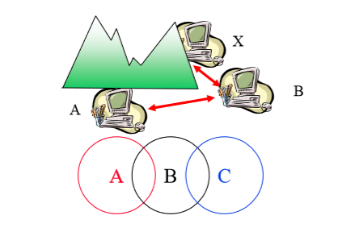
Reliable Data Delivery
Hidden Terminal Problem
A can hear B, B can hear C, but C cannot hear A.
C may start transmitting while A is also transmitting
A and C can't detect collision.
CSMA/CD is not possible
Only the receiver can help avoid collision

Slide 77
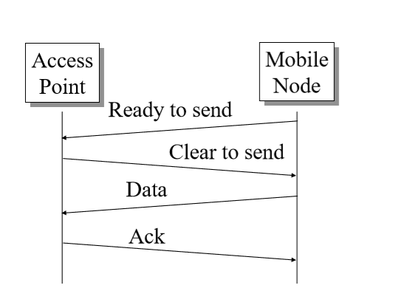
Reliable Data Delivery
4 4-Way Handshake

Slide 78
MEDIUM Access control
Distributed coordination function (DCF)
Decentralized
Point coordination function (PCF)
Centralized
MAC algorithm called Distributed foundation wireless MAC (DFWMAC)
Centralized and decentralized mechanisms together
Wireless LAN Technology and the IEEE 802.11 Wireless LAN Standard 11-78

Slide 79
11.9 IEEE 802.11 Protocol Architecture

Slide 80
Distributed coordination function
Decentralized
Carrier sense multiple access (CSMA)
Avoids collision by sending a short message:
Ready to send (RTS)
RTS contains destination address and duration of message.
Tells everyone to backoff for the duration.
Destination sends: Clear to send (CTS) Other stations set their network allocation vector (NAV) and wait for that duration
Can not detect collision ➔ Each packet is acked.
MAC-level retransmission if not acked.

Slide 81
Distributed coordination function
Carrier sense multiple access (CSMA)
Listen to the medium
If idle, then transmit
If not, wait a random time
If busy again, expand the mean waiting time, randomly wait, and try again.
Binary exponential backoff describes this procedure
The backoff is the waiting process
Mean random waiting times get exponentially larger
By a factor of 2 each time, hence the term binary.
This process responds to heavy loads
Since nodes do not know the loads of other nodes trying to send.

Slide 82
11.10 IEEE 802.11 Medium Access Control Logic
Wireless LAN Technology and the IEEE 802.11 Wireless LAN Standard 11-82

Slide 83
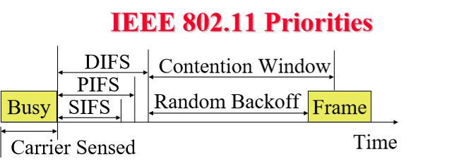
IEEE 802.11 Priorities
Initial interframe space (IFS)
Highest priority frames, e.g., Acks, use short IFS (SIFS)
Medium priority time-critical frames use “Point Coordination Function IFS” (PIFS)
Asynchronous data frames use “Distributed coordination function IFS” (DIFS)

Slide 84
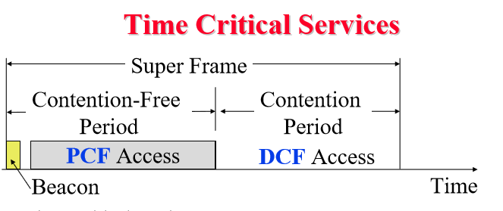
Time Critical Services
Timer critical services use Point Coordination Function
The point coordinator allows only one station to access
Coordinator sends a beacon frame to all stations. Then uses a polling frame to allow a particular station to have contention-free access
Contention Free Period (CFP) varies with the load

Slide 85
IEEE 802.11 DCF BackofF
MAC works with a single FIFO Queue
Three variables:
Contention Window (CW)
Backoff count (BO)
Network Allocation Vector (NAV)
If a frame (RTS, CTS, Data, Ack) is heard, NAV is set to the duration in that frame. Stations sense the media after NAV expires.
If the medium is idle for DIFS, and backoff (BO) is not already active, the station draws a random BO in [0, CW] and sets the backoff timer.
If the medium becomes busy during backoff, the timer is stopped and a new NAV is set. After NAV, back off continues.

Slide 86
IEEE 802.11 DCF Backoff (cont)
Initially and after each successful transmission:
CW = CWmin
After each unsuccessful attempt
CW = min{2CW + 1, CWmax }
Example: CWmin=3, CWmax=127
3, 7, 15, 31, 63, 127, 127, 127, …

Slide 87
Typical Parameter Values
11a: Slot time = 9 us, SIFS= 16 us, CWmin= 15, CWmax=1023
11b: Slot time = 20 us, SIFS = 10 us, CWmin= 31, CWmax=1023
11g: Slot time = 20 us or 9 us, SIFS = 10 us, CWmin= 15 or 31, CWmax=1023
PIFS = SIFS + 1 slot time
DIFS = SIFS + 2 slot times

Slide 88
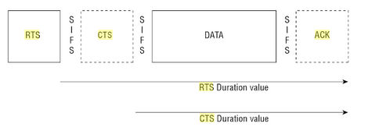
Virtual Carrier Sense
Every frame has a “Duration ID” which indicates how long the medium will be busy.
RTS has duration of SIF + CTS + SIF + Frame + SIF + Ack
CTS has duration of SIF + Frame + SIF + Ack
Frame has a duration of Frame SIF + ACK
ACK has a duration of ACK
All stations keep a “Network Allocation Vector (NAV)”timer in which they record the duration of the each frame they hear.
Stations do not need to sense the channel until NAV becomes zero.

Slide 89
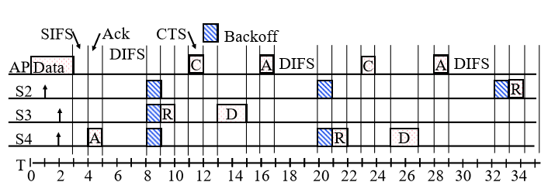
DCF Example
Example: Slot Time = 1, Cwmin = 5, DIFS=3, PIFS=2, SIFS=1
T=1 Station 2 wants to transmit but the media is busy
T=2 Stations 3 and 4 want to transmit but the media is busy
T=3 Station 1 finishes transmission.
T=4 Station 1 receives ack for its transmission (SIFS=1)
Stations 2, 3, 4 set their NAV to 1.
T=5 Medium becomes free
T=8 DIFS expires. Stations 2, 3, 4 draw backoff count between 0 and 5. The counts are 3, 1, 2

Slide 90
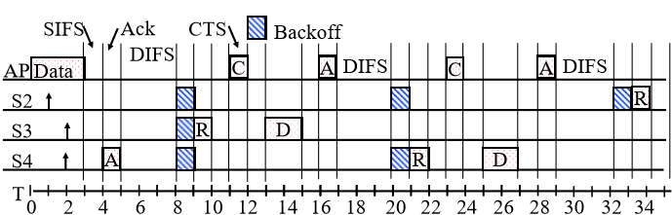
DCF Example (Cont)
T=9 Station 3 starts transmitting. Announces a duration of 8 (RTS + SIFS + CTS + SIFS + DATA + SIFS + ACK). Station 2 and 4 pause backoff counter at 2 and 1 resp. and wait till T=17
T=15 Station 3 finishes data transmission
T=16 Station 3 receives Ack.
T=17 Medium becomes free
T=20 DIFS expires. Station 2 and 4 notice that there was no transmission for DIFS. Stations 2 and 4 start their backoff counter from 2 and 1, respectively.
T=21 Station 4 starts transmitting RTS

Slide 91
Point coordination function
Centralized control
Point coordinator polls devices
To give them permission to send
On a schedule the point coordinator determines
The superframe allows time to be shared between DCF and PCF
PCF starts the superframe and can only use a certain part of the superframe time

Slide 92
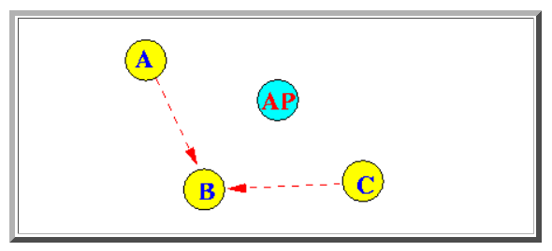
Point coordination function
Example: Suppose A and C want to send a frame to B

Slide 93
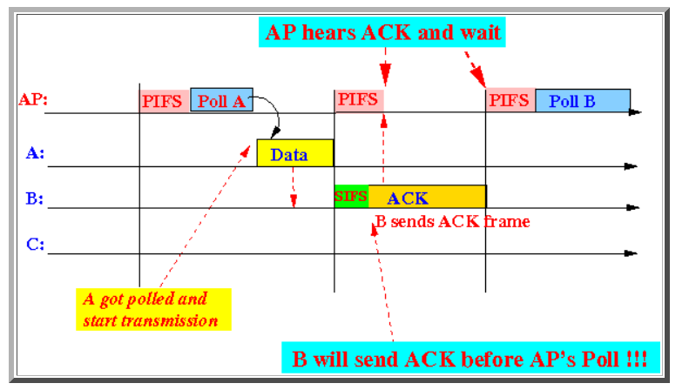
Point coordination function
Example: Sequence of events

Slide 94
11.12 IEEE 802.11 MAC Frame Format
Notes:
• Protocol Version: 802.11 version, currently version 0.
• Type: Identifies the frame as control, management, or data.
• Subtype: Further identifies the function of frame. Table 11.4 defines the valid
combinations of type and subtype. Association request, response,
RTS , CTS
• To DS: The MAC coordination sets this bit to 1 in a frame destined to the
distribution system.
• From DS: The MAC coordination sets this bit to 1 in a frame leaving the distribution
system.
• More Fragments: Set to 1 if more fragments follow this one.
• Retry: Set to 1 if this is a retransmission of a previous frame.
Frame control” indicate the type o frame (Control, management, or data ) and provide control information
WEP – 1 if Wired Equivalent Privacy (WEP) or Wi-Fi Protected Access (WPA) is implemented
Order – 1 if any data frame is sent using the Strictly Ordered service
Address:
Addresses: The number and meaning of the 48-bit address fields depend on
context. The transmitter address and receiver address are the MAC addresses
of stations joined to the BSS that are transmitting and receiving frames over
the WLAN. The service set identifier (SSID) identifies the WLAN over which
a frame is transmitted
Duration/Connection ID:
If used as duration field, indicates time (in us) channel will be allocated for successful transmission of MAC frame. Includes time until the end of Ack
In some control frames, contains association or connection identifier
Sequence Control:
4-bit fragment number subfield
For fragmentation and reassembly
12-bit sequence number used to
Number frames sent between given transmitter and receiver
• QoS Control: Contains information relating to the IEEE 802.11 quality of service
(QoS) facility.
• High Throughput Control: This field contains control bits related to the operation
of 802.11n, 802.11ac, and 802.11ad.
Frame Body: Contains an MSDU (MAC service Data Unit). The MSDU is a LLC protocol data unit
Frame Check Sequence: A 32-bit cyclic redundancy check.

Slide 95
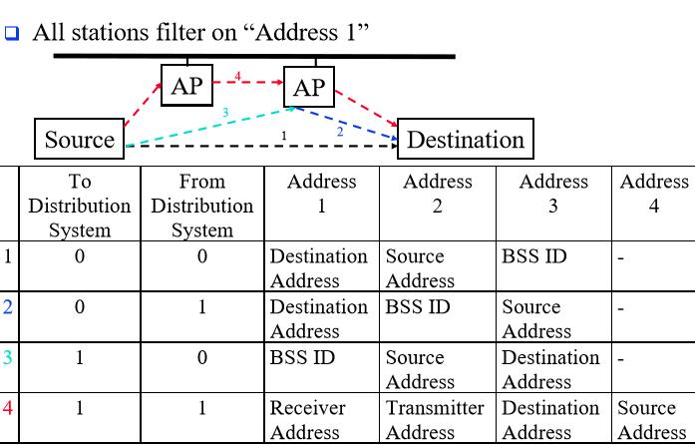
802.11 Frame Address Fields
Notes:
48 bit address

Slide 96
MAC Frame Fields
Frame Control – frame type, control information
Duration/connection ID – channel allocation time
Addresses – context dependent, types include source and destination
Sequence control – numbering and reassembly
Frame body – MSDU or fragment of MSDU
Frame check sequence – 32-bit CRC
Wireless LAN Technology and the IEEE 802.11 Wireless LAN Standard 11-96

Slide 97
Frame Control Fields
Protocol version – 802.11 version
Type – control, management, or data
Subtype – identifies function of frame
To DS – 1 if destined for DS
From DS – 1 if leaving DS
More fragments – 1 if fragments follow
Retry – 1 if retransmission of previous frame
Wireless LAN Technology and the IEEE 802.11 Wireless LAN Standard 11-97

Slide 98
Frame Control Fields
Power management – 1 if transmitting station is in sleep mode
More data – Indicates that station has more data to send
WEP – 1 if Wired Equivalent Privacy (WEP) or Wi-Fi Protected Access (WPA) is implemented
Order – 1 if any data frame is sent using the Strictly Ordered service
Wireless LAN Technology and the IEEE 802.11 Wireless LAN Standard 11-98

Slide 99
Control Frame Subtypes
Power save – poll (PS-Poll)
Request to send (RTS)
Clear to send (CTS)
Acknowledgment
Contention-free (CF)-end
CF-end + CF-ack
Wireless LAN Technology and the IEEE 802.11 Wireless LAN Standard 11-99

Slide 100
Data Frame Subtypes
Data-carrying frames
Data
Data + CF-Ack
Data + CF-Poll
Data + CF-Ack + CF-Poll
Other subtypes (don’t carry user data)
Null Function
CF-Ack
CF-Poll
CF-Ack + CF-Poll
Wireless LAN Technology and the IEEE 802.11 Wireless LAN Standard 11-100

Slide 101
Management Frame Subtypes
Association request
Association response
Reassociation request
Reassociation response
Probe request
Probe response
Beacon
Wireless LAN Technology and the IEEE 802.11 Wireless LAN Standard 11-101

Slide 102
Management Frame Subtypes
Announcement traffic indication message
Dissociation
Authentication
Deauthentication
Wireless LAN Technology and the IEEE 802.11 Wireless LAN Standard 11-102

Slide 103
Summary
IEEE 802.11 Introduction
IEEE 802.11 Features
WLAN Architecture
IEEE 802.11 Protocol Architecture
IEEE 802.11 LCC
EEE 802.11 MAC
MAC Frame Format
Notes:
We will talk about wireless network: WLAN
IEEE 802.11 physical layer
Security
Quality of service

